Slide 1


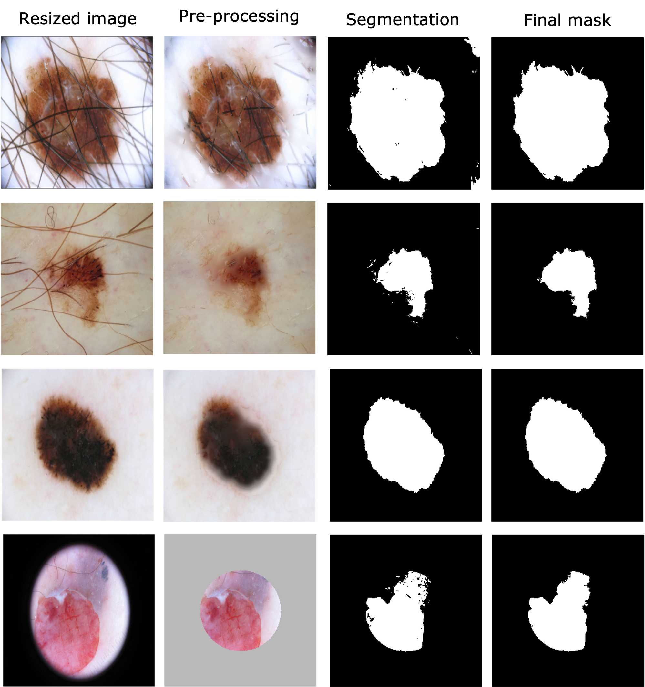
SKIN LESION SEGMENTATION AND
CLASSIFICATION WITH IMAGE PROCESSING,
MACHINE LEARNING AND
DEEP LEARNING APPROACHES
ADVANCED IMAGE ANALYSIS
MACHINE AND DEEP LEARNING
KAZI SAEED ALAM
GONZALO ESTEBAN MOSQUERA ROJAS
JOSÉ CARLOS REYES HERNÁNDEZ
UNIVERSITY OF CASSINO AND SOUTHERN LAZIO
Cassino, Italy. June 28th, 2022

Slide 2
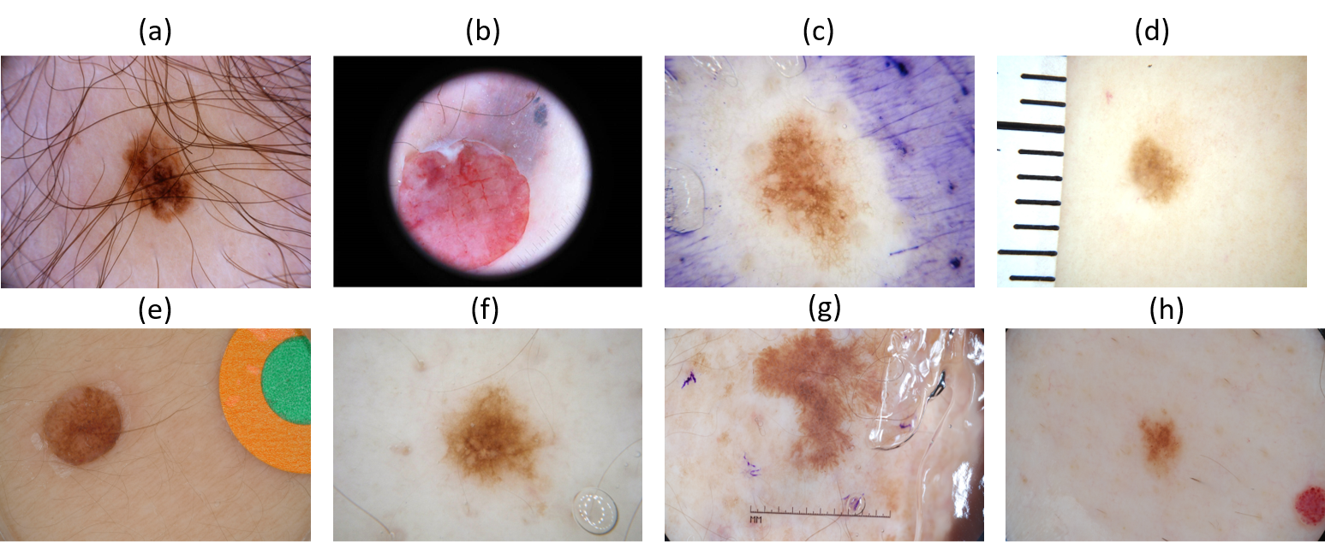
EXAMPLES OF ARTIFACTS IN THE SKIN LESION IMAGES

Slide 3
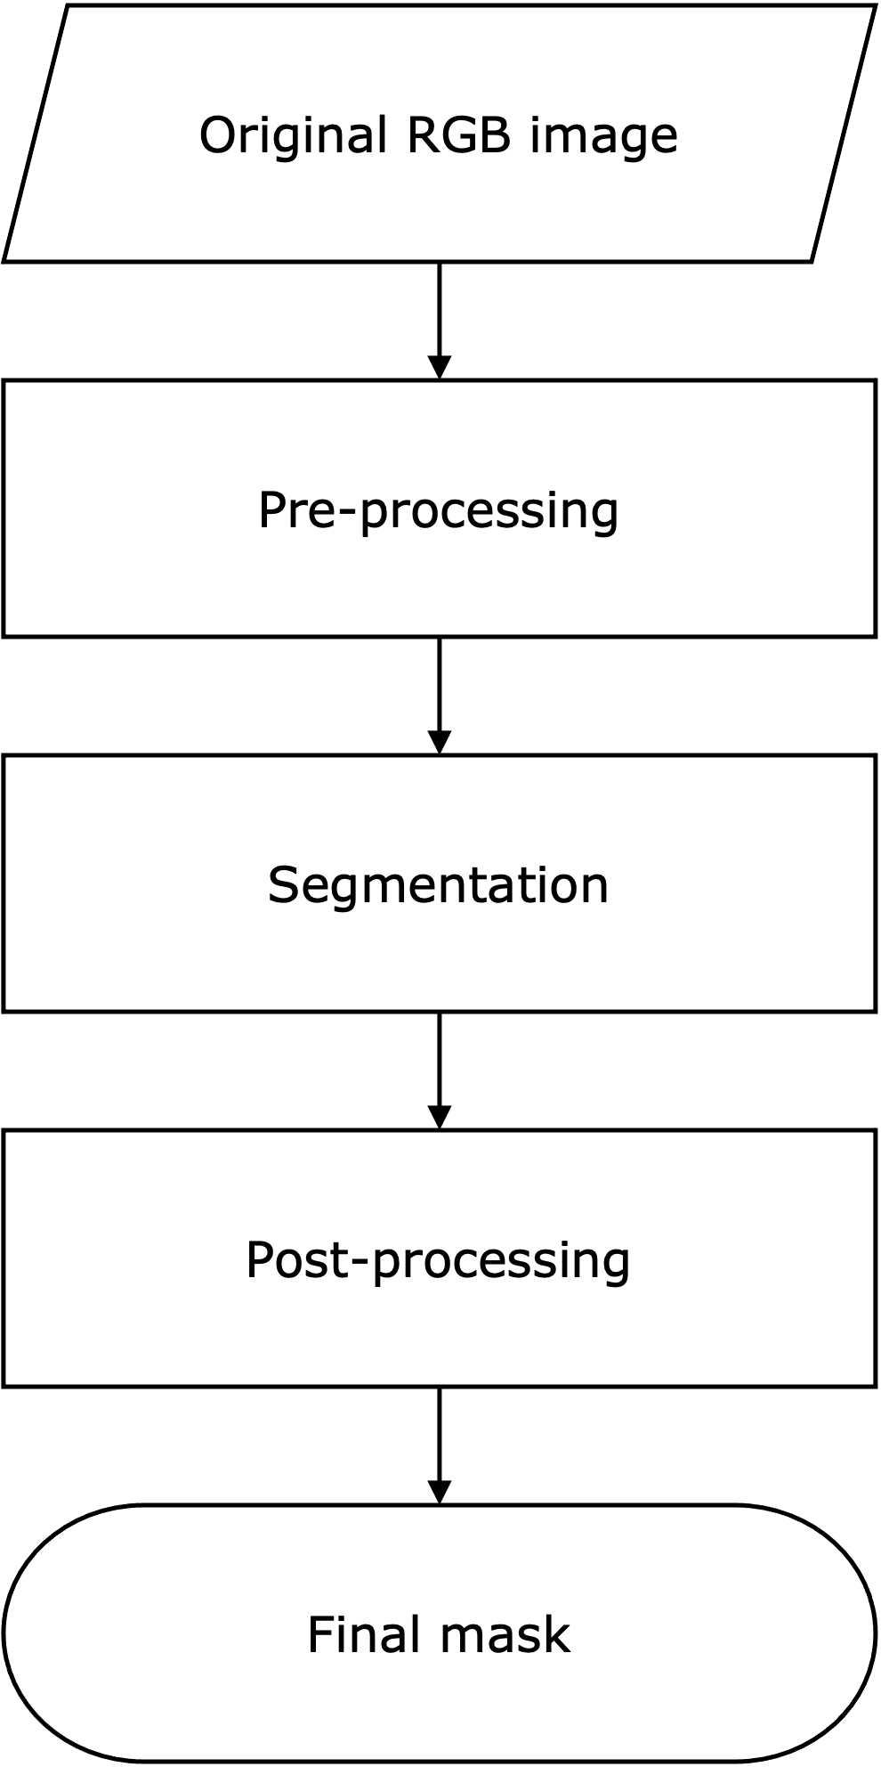
ADVANCED IMAGE ANALYSIS (AIA): SEGMENTATION WORKFLOW

Slide 4
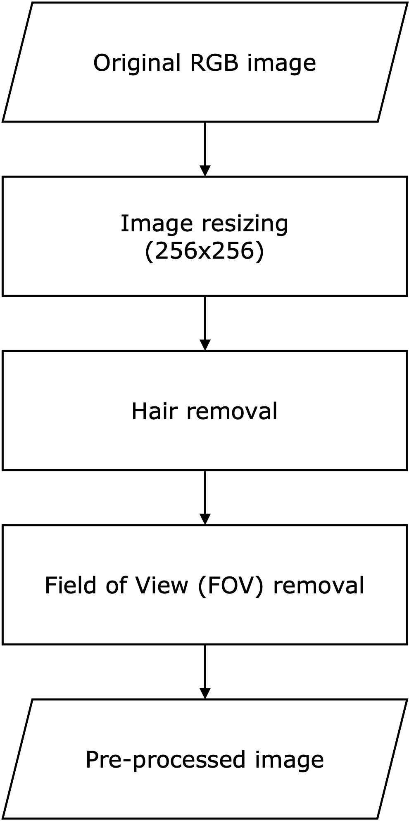
WORKFLOW: PRE-PROCESSING (AIA)

Slide 5
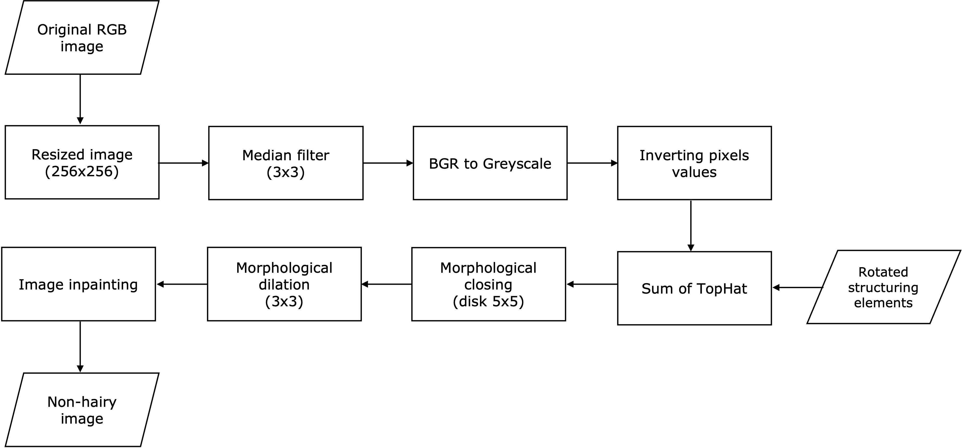
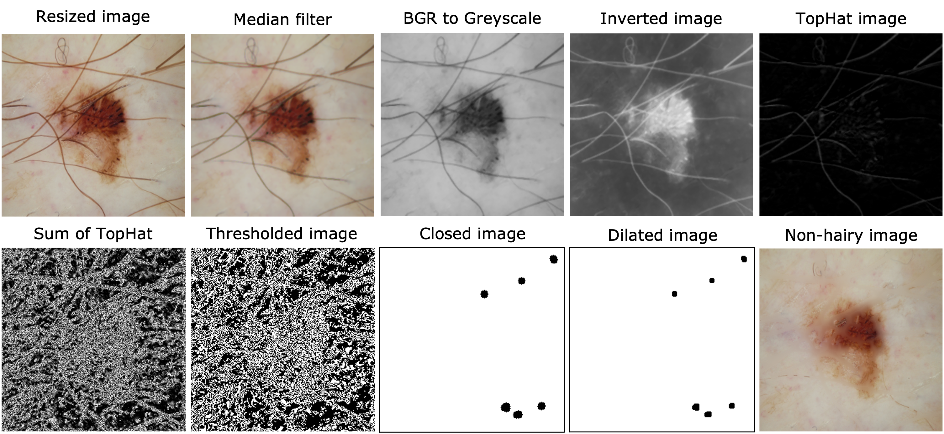
PRE-PROCESSING: HAIR REMOVAL

Slide 6
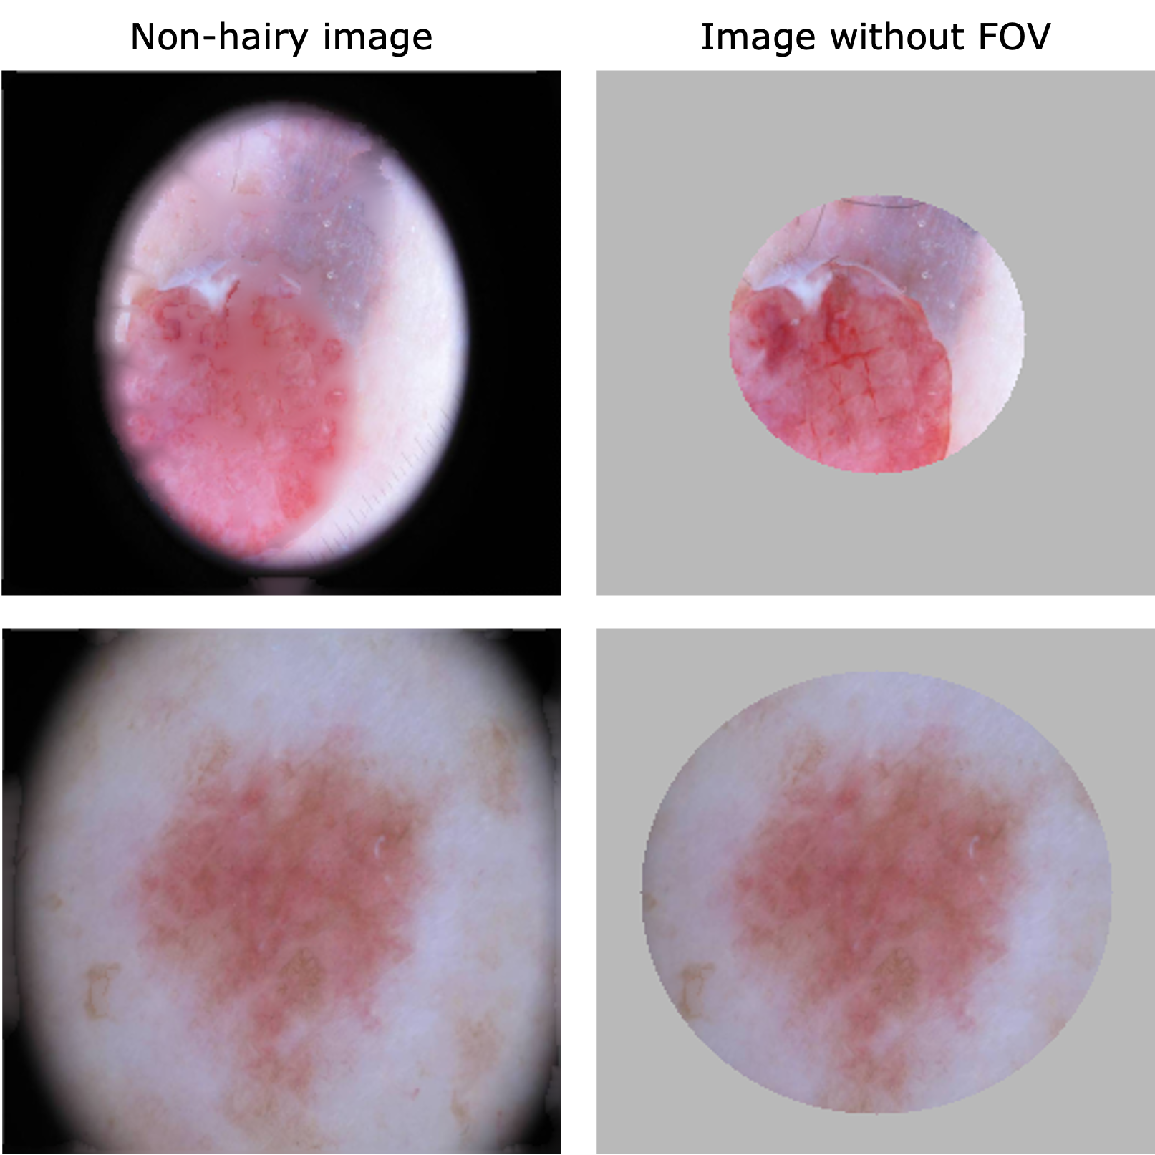
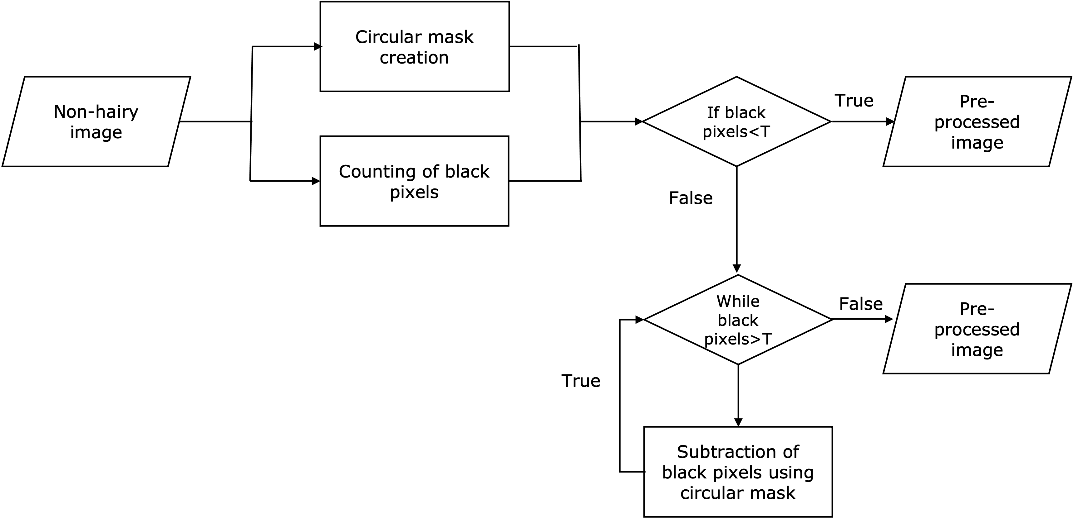
PRE-PROCESSING: FOV REMOVAL

Slide 7
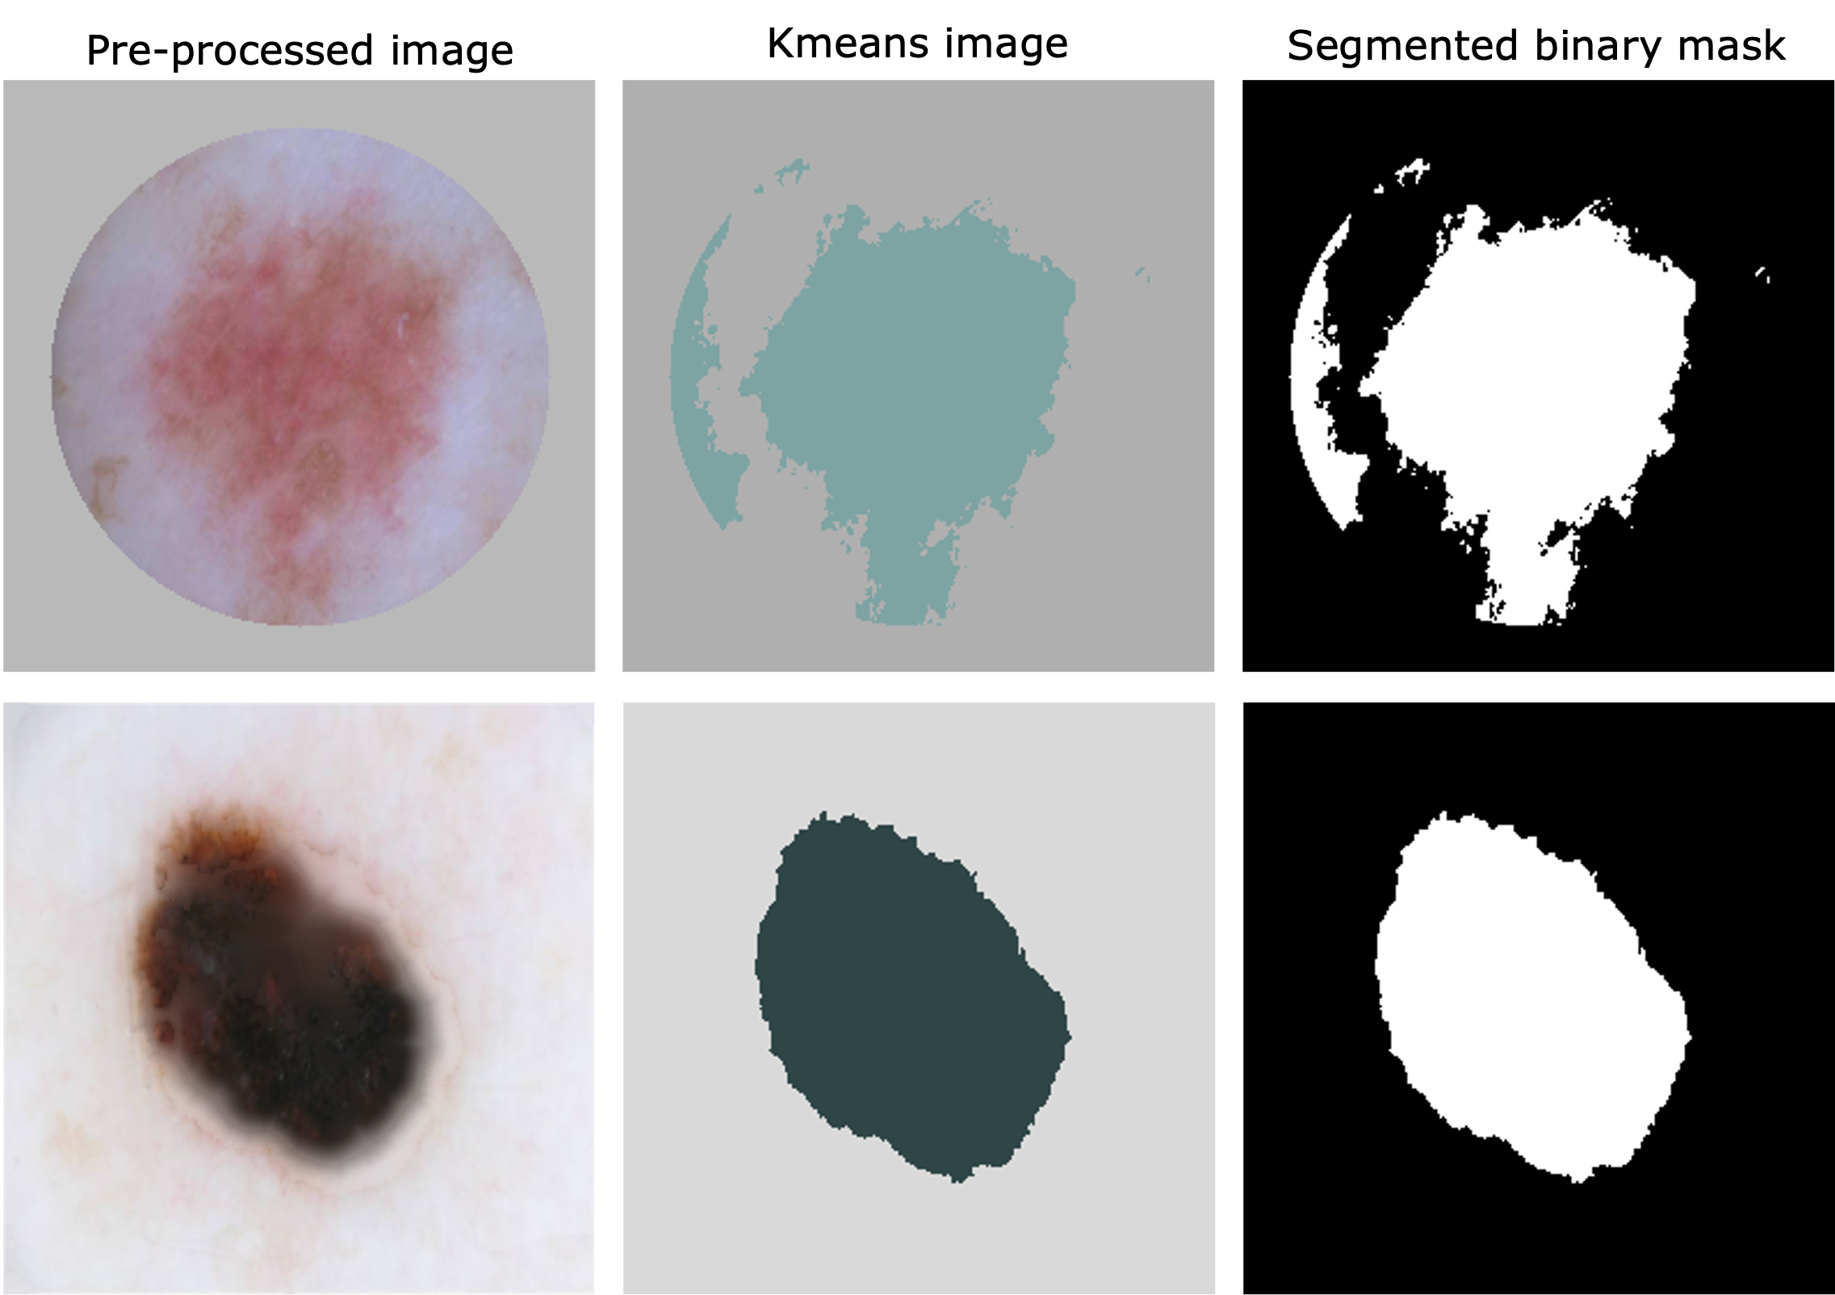
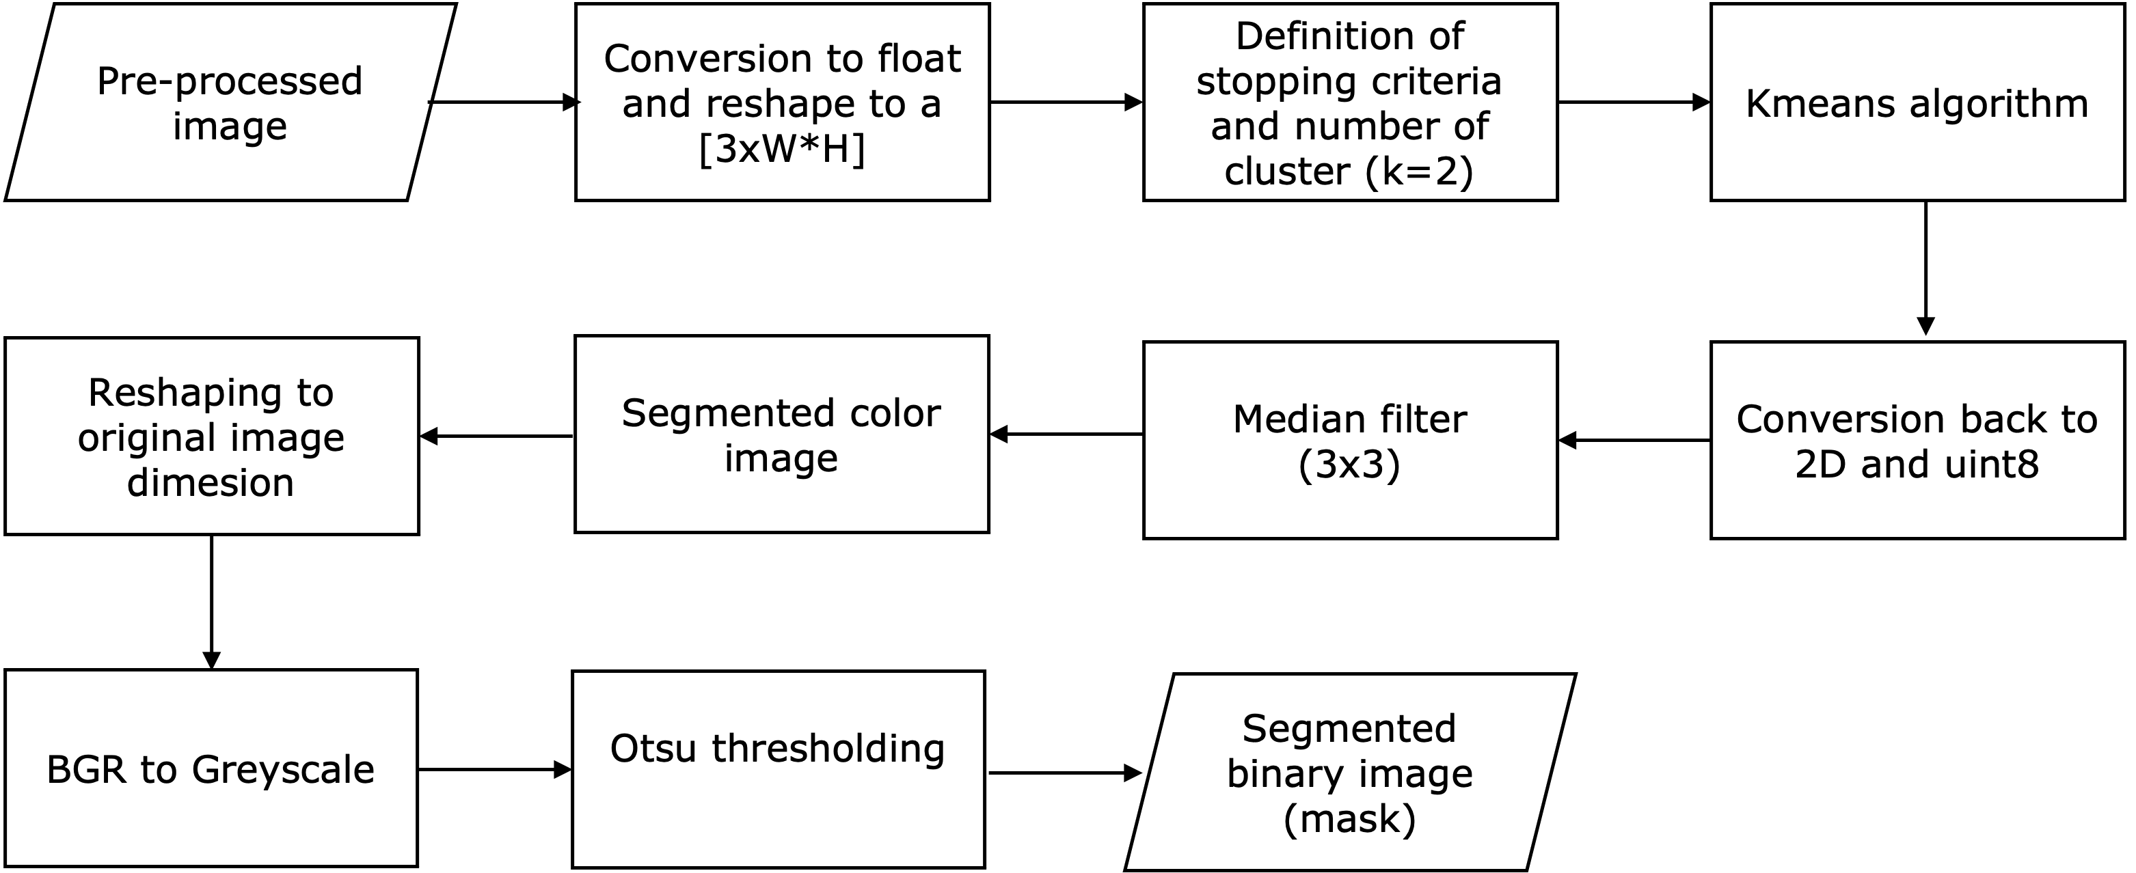
SEGMENTATION: K-MEANS

Slide 8
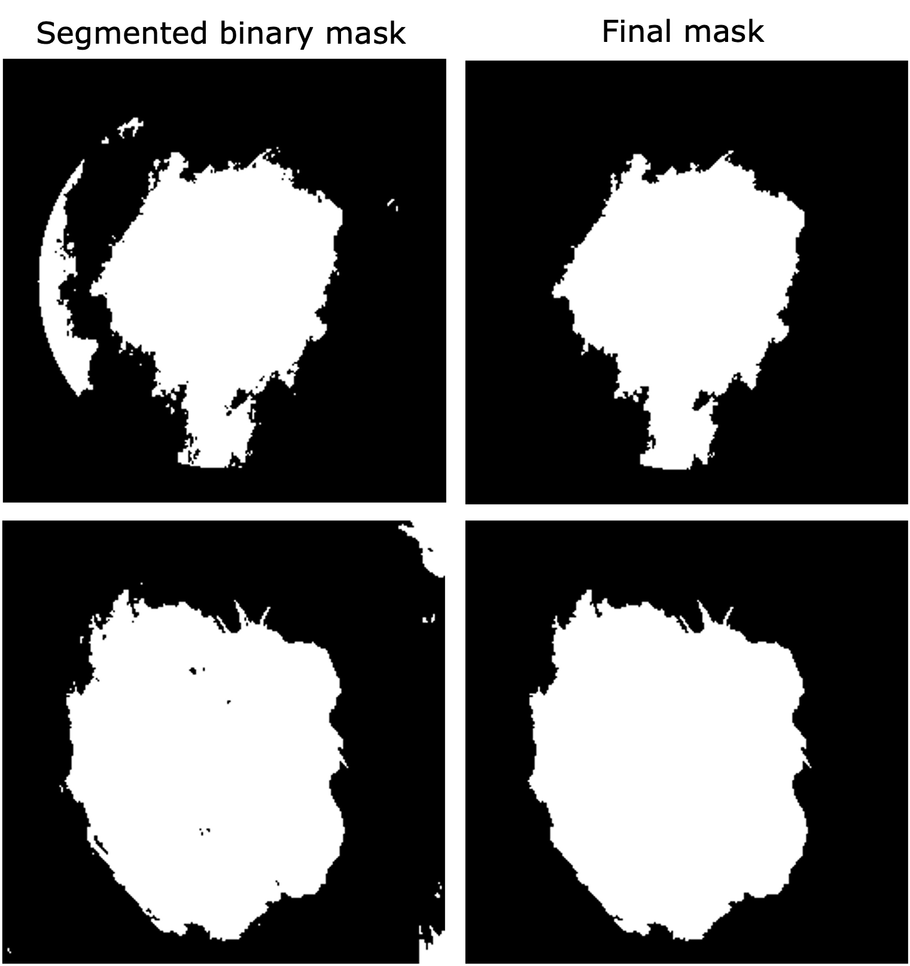
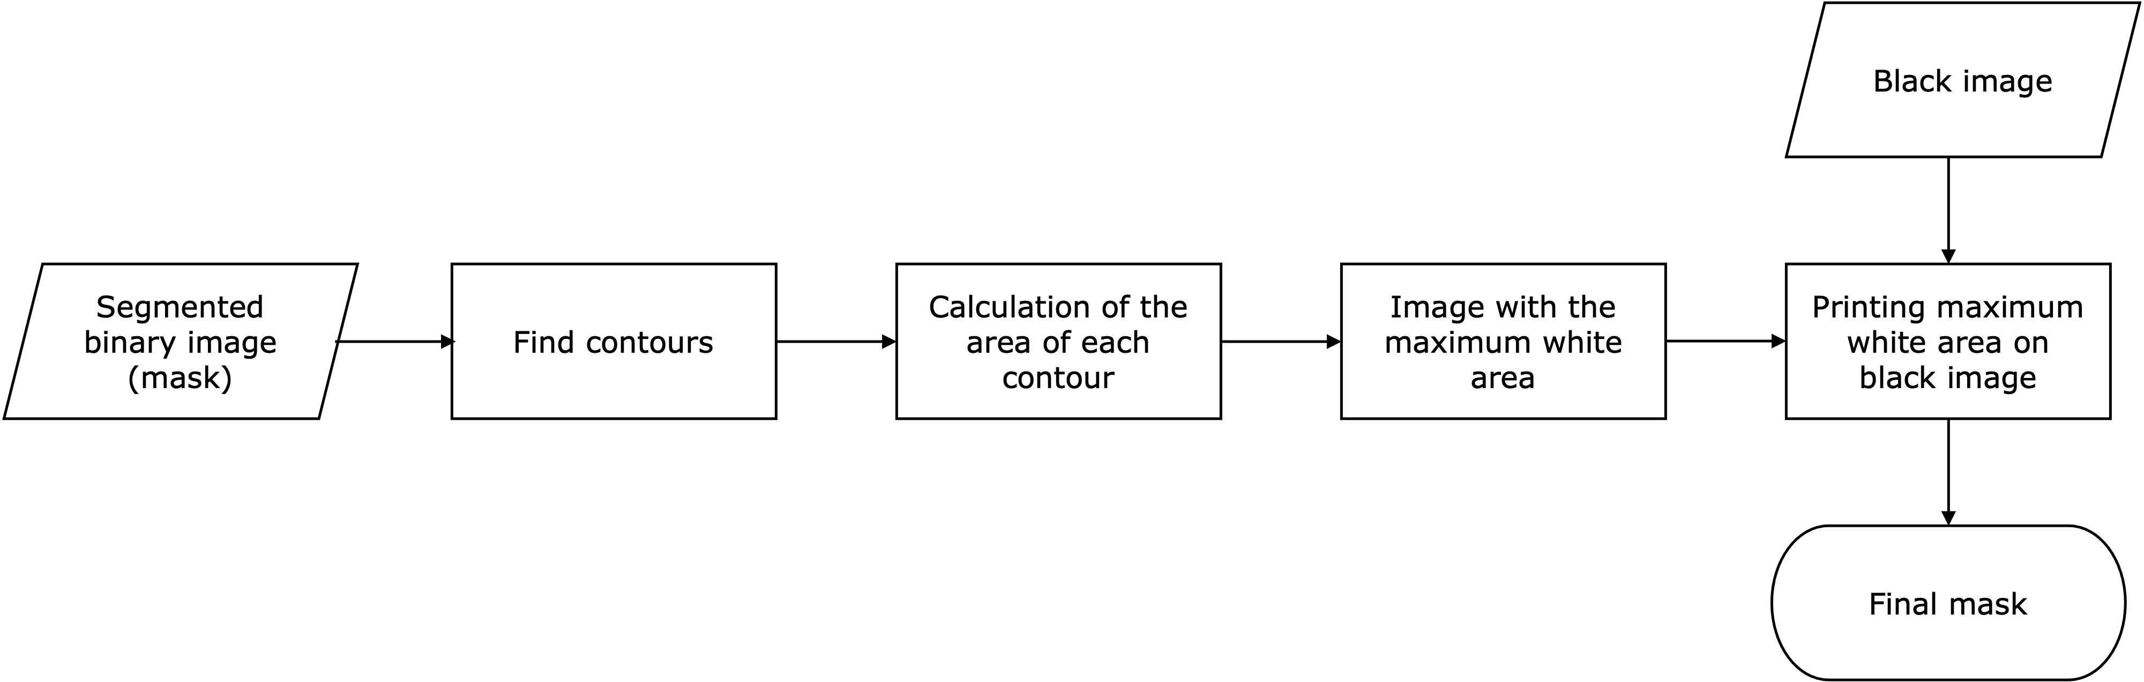
POST-PROCESSING: EXTRACTING LARGEST CONNECTED COMPONENTS

Slide 9
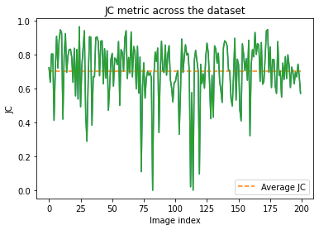
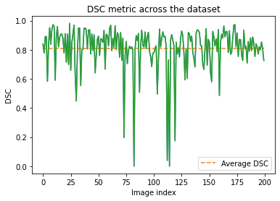
RESULTS (AIA): JACCARD AND DSC METRICS

Slide 10
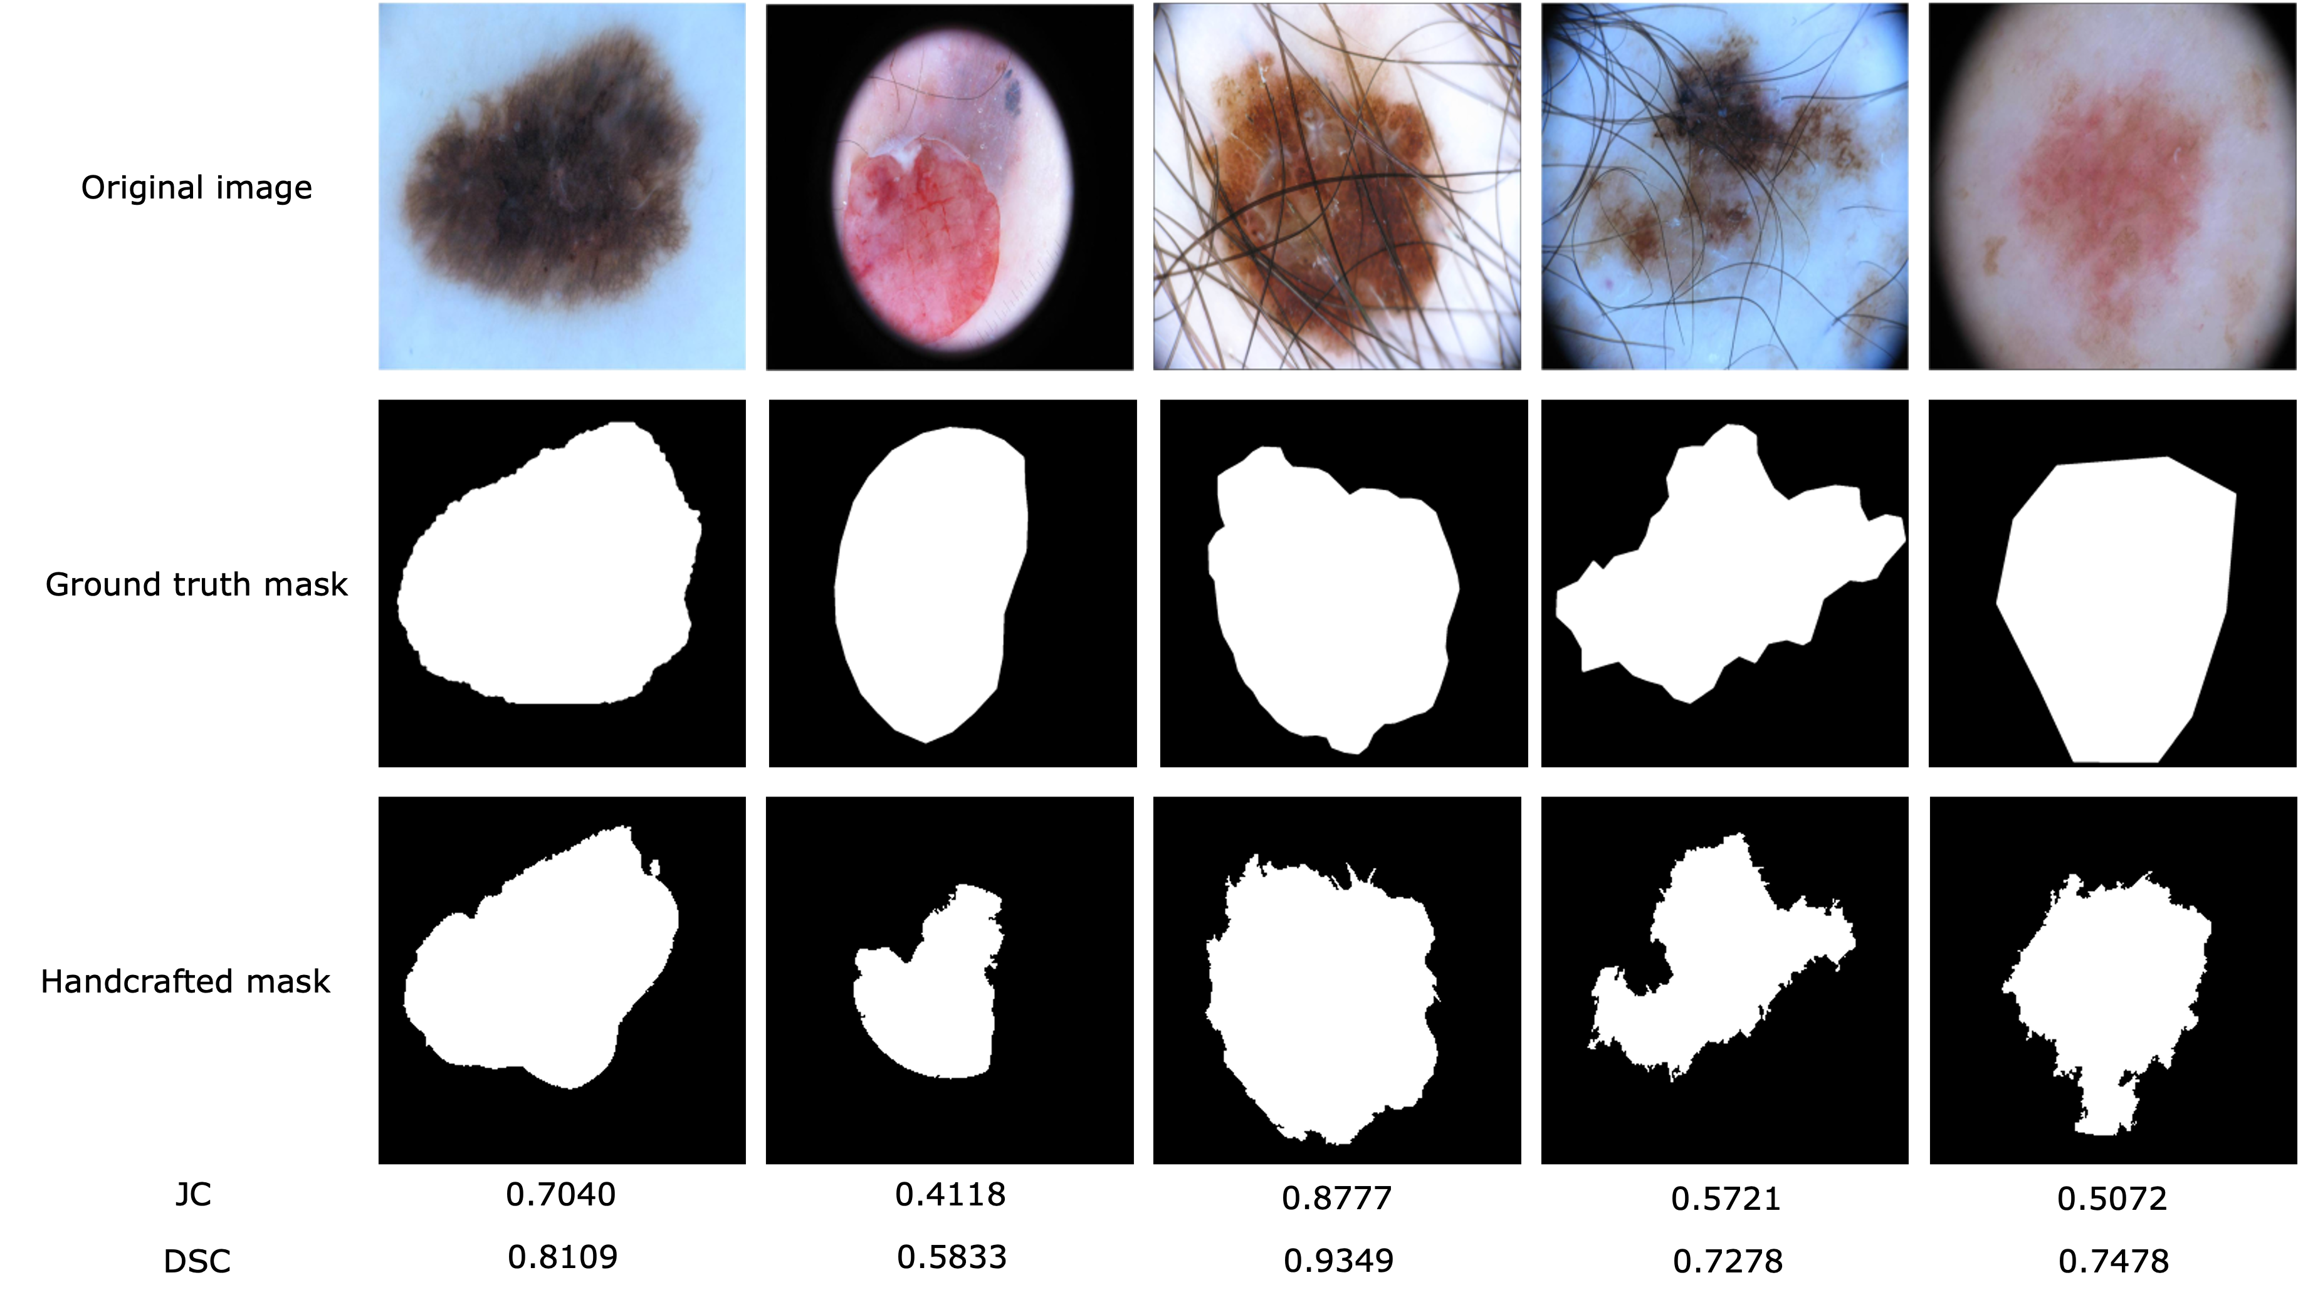
RESULTS (AIA): QUALITATIVE AND QUANTITAVE

Slide 11
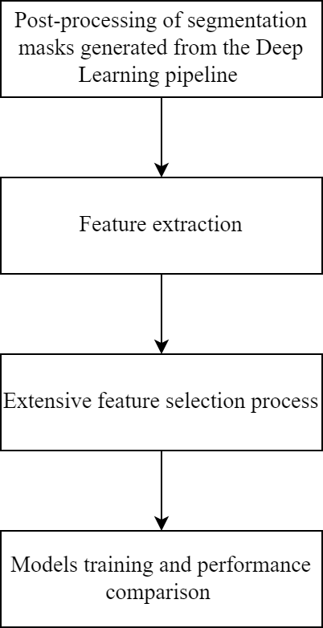
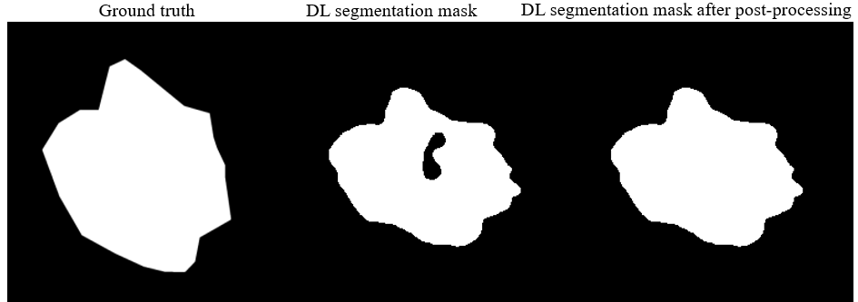
MACHINE LEARNING: CLASSIFICATION WORKFLOW

Slide 12
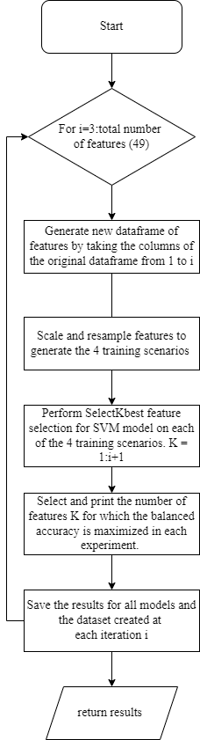
MACHINE LEARNING: FEATURE SEARCH ALGORITHM

Slide 13
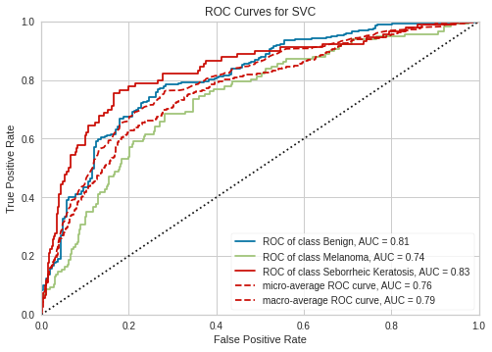
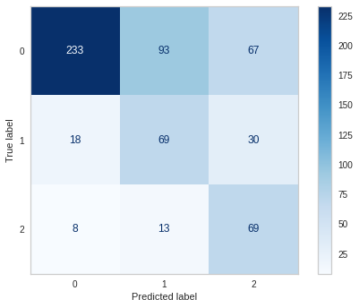
RESULTS (ML): SVC METRICS

Slide 14
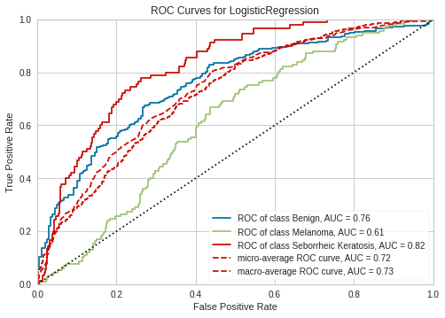
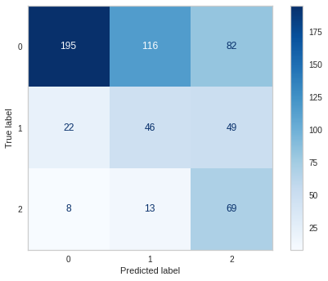
RESULTS (ML): LOGISTIC REGRESSION METRICS

Slide 15
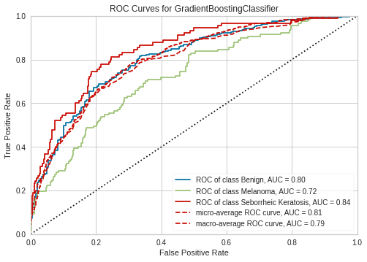
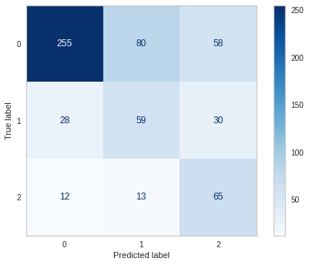
RESULTS (ML): GRADIENT BOOSTING METRICS

Slide 16
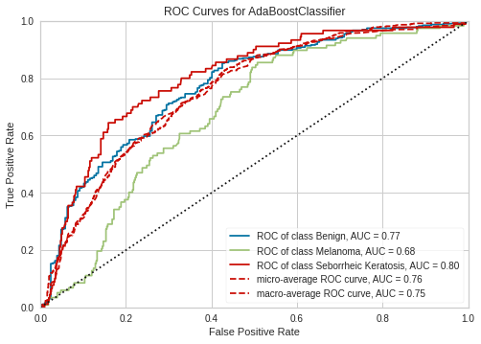
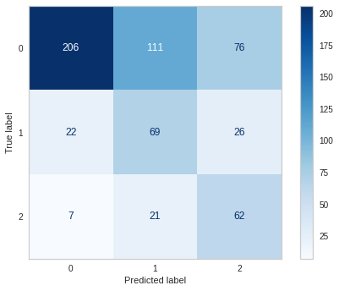
RESULTS (ML): ADABOOST METRICS

Slide 17
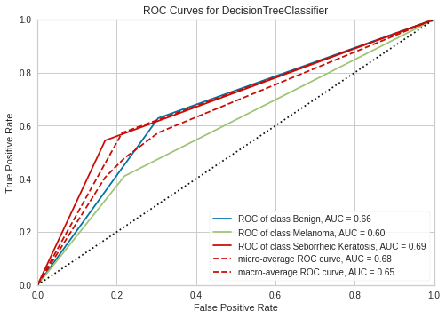
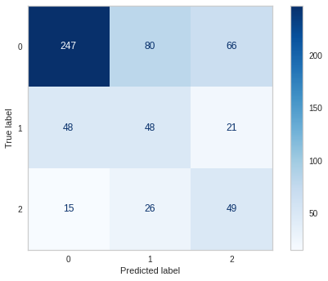
RESULTS (ML): DECISION TREE METRICS

Slide 18
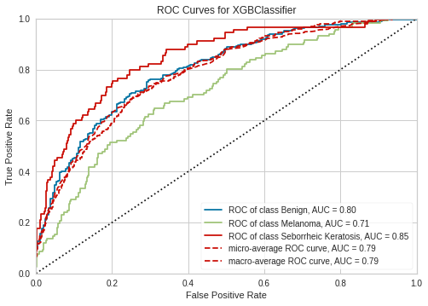
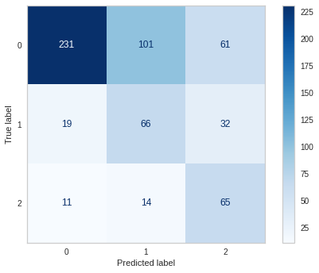
RESULTS (ML): XGBCLASSIFIER METRICS

Slide 19
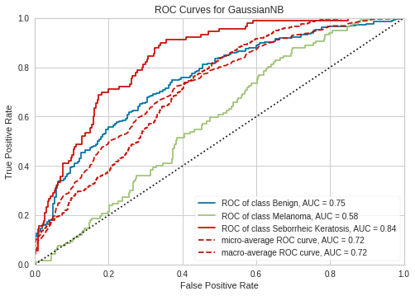
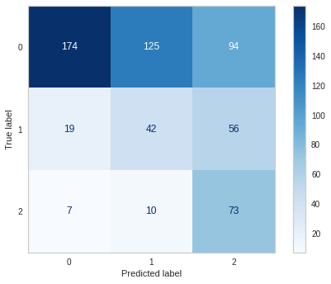
RESULTS (ML): GAUSSIAN NAÏVE-BAYES METRICS

Slide 20
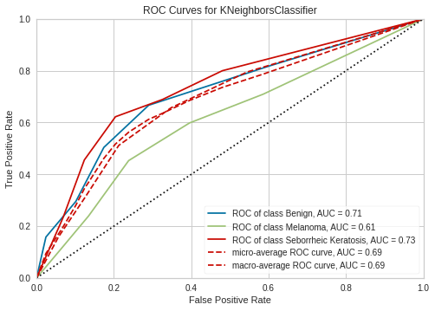
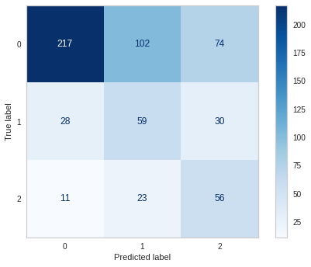
RESULTS (ML): KNN METRICS

Slide 21
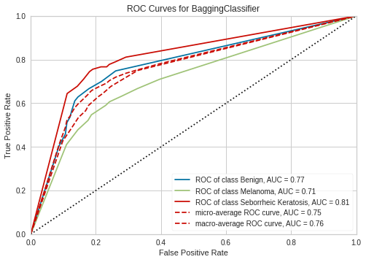
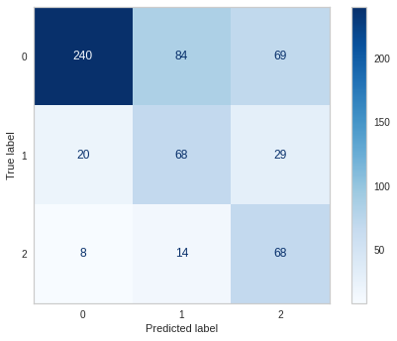
RESULTS (ML): BAGGING CLASSIFIER METRICS

Slide 22
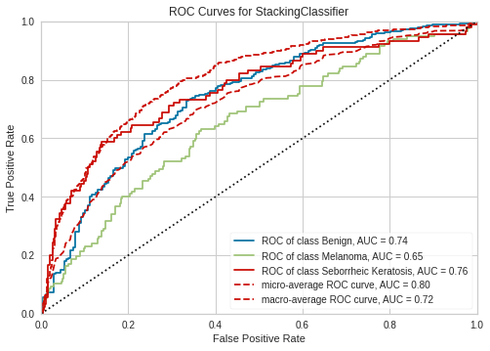
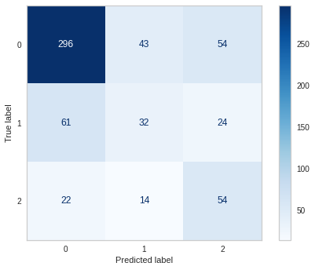
RESULTS (ML): STACKING CLASSIFIER METRICS

Slide 23
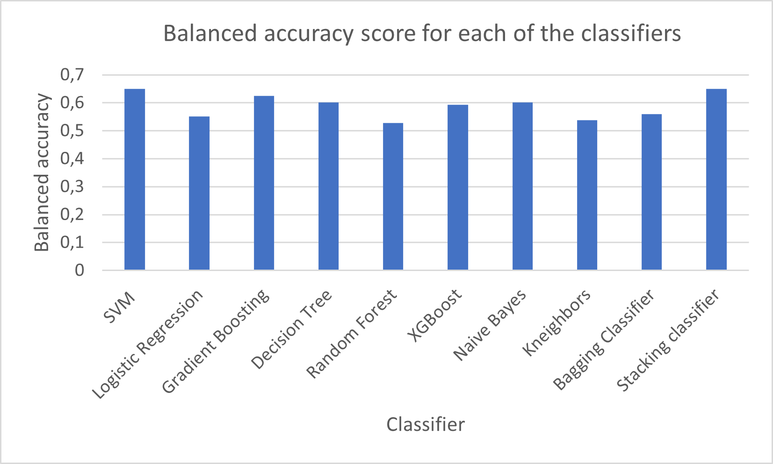
RESULTS (ML): OVERALL CLASSIFIERS PERFORMANCE

Slide 24
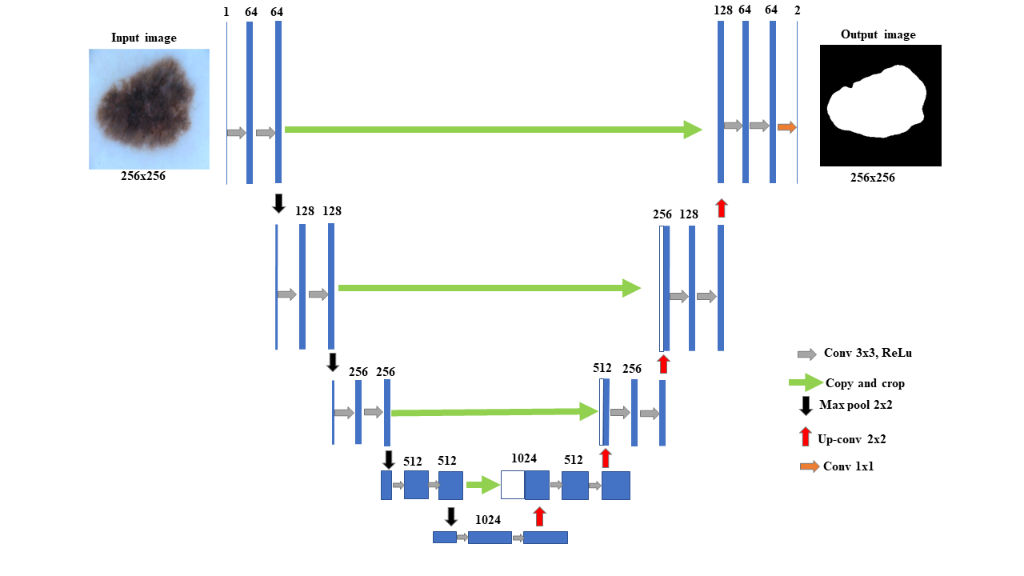
DEEP LEARNING-SEGMENTATION (DL):
UNET ARCHITECTURE

Slide 25
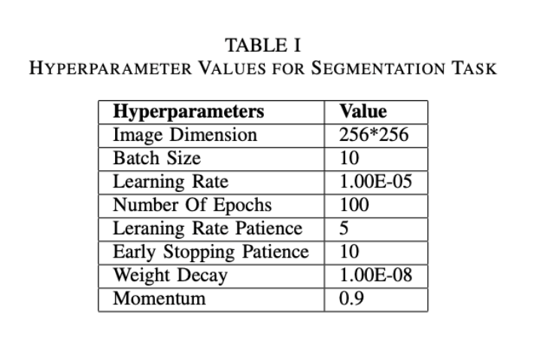
RESULTS (DL): HYPER-PAREMETERS TUNING

Slide 26
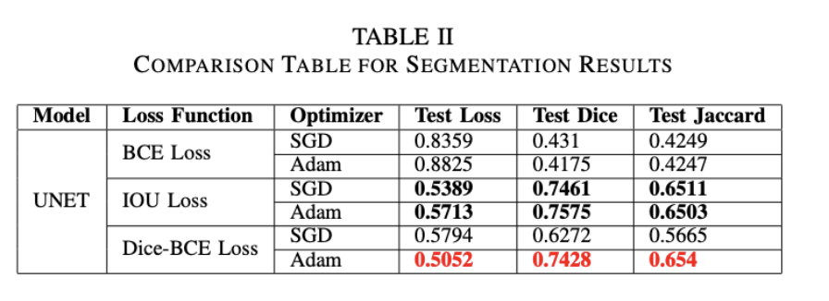
RESULTS (DL): AUTOMATIC SEGMENTATION
(U-NET)

Slide 27
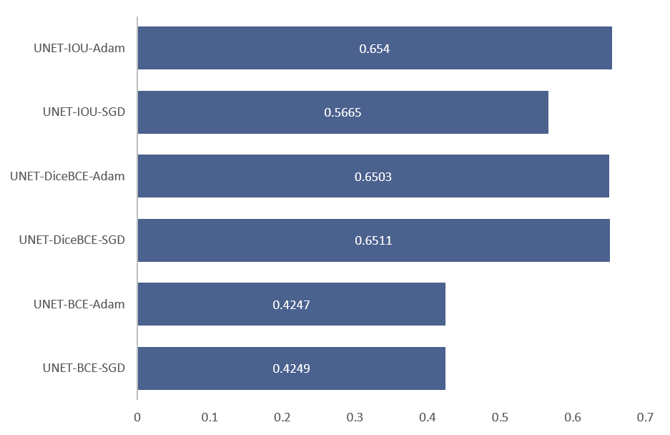
RESULTS (DL): MODELS JACCARD SCORE

Slide 28
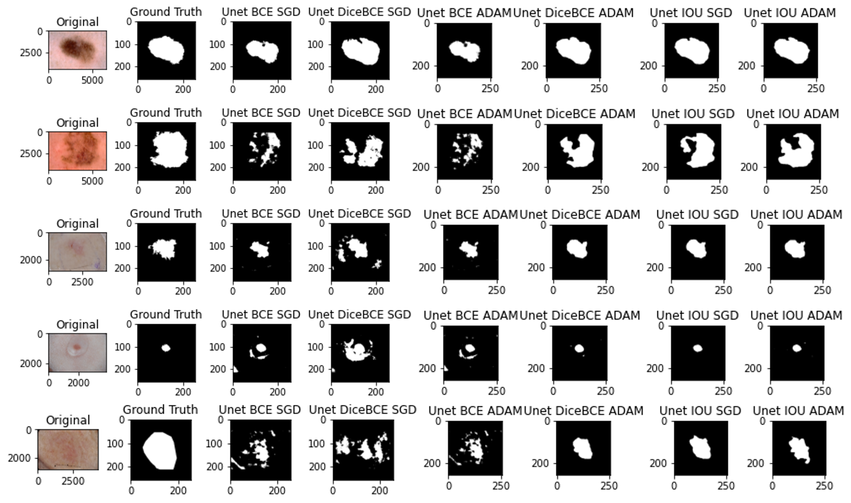
RESULTS (DL): QUALITATIVE RESULTS

Slide 29
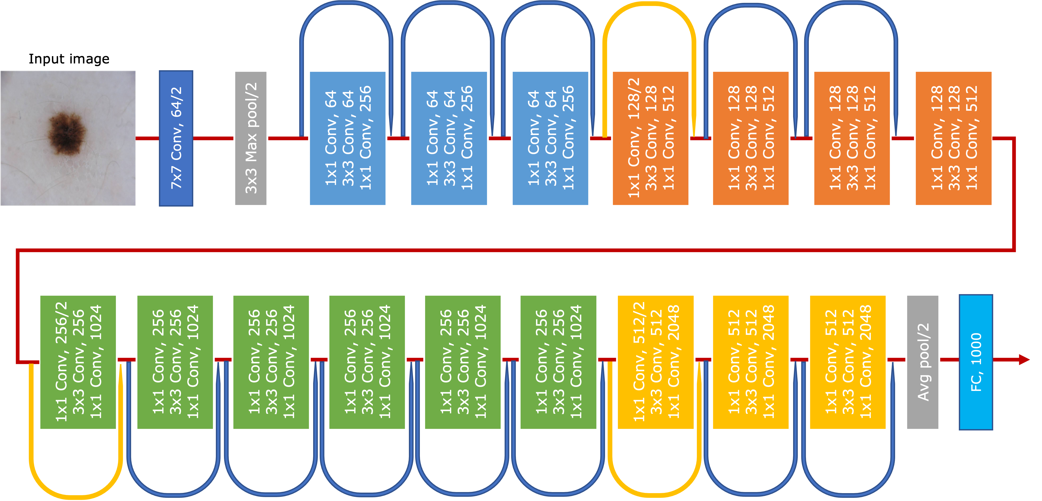
CLASSIFICATION (DL): RESNET50 ARCHITECTURE

Slide 30
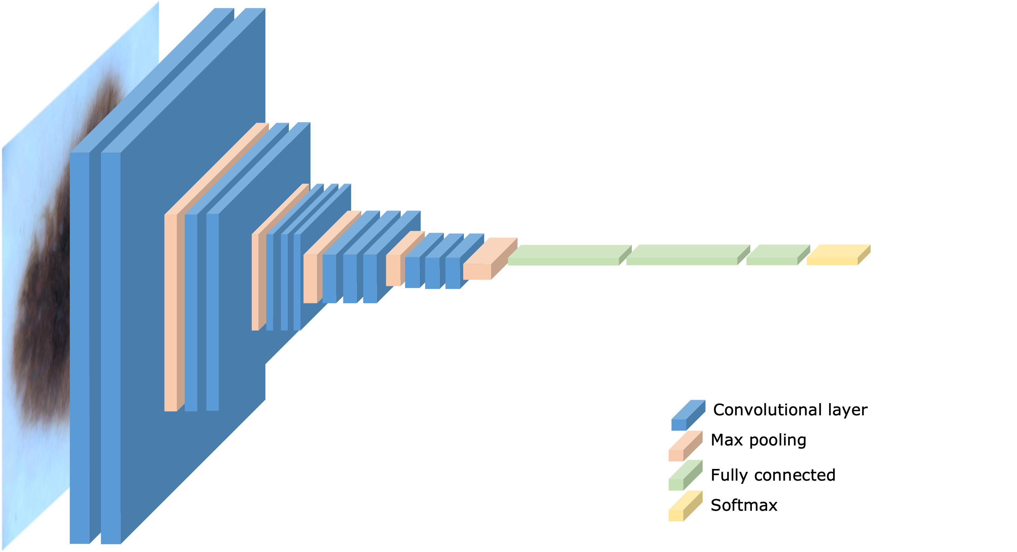
CLASSIFICATION (DL): VGG16 ARCHITECTURE

Slide 31
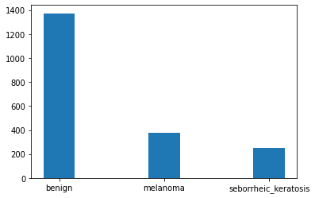
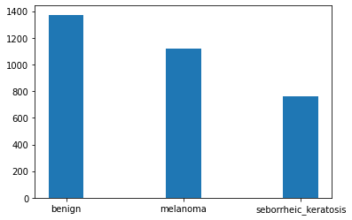
CLASSIFICATION (DL): VISUALIZATION OF DATA
INITIAL DISTRIBUTION OF TRAINING DATA
DISTRIBUTION AFTER DATA AUGMENTATION

Slide 32
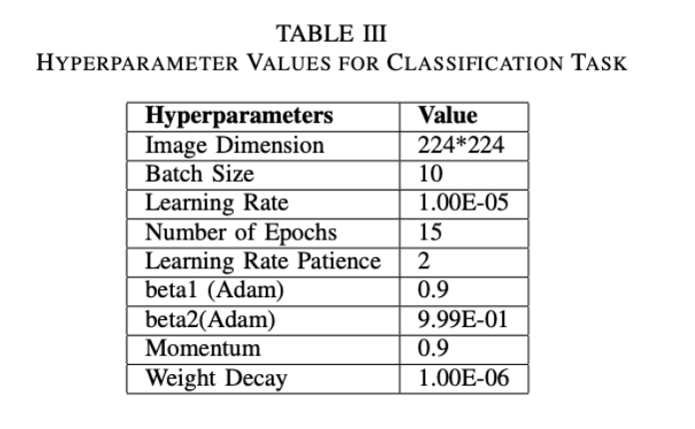
RESULTS (DL): HYPER-PAREMETERS TUNNING

Slide 33
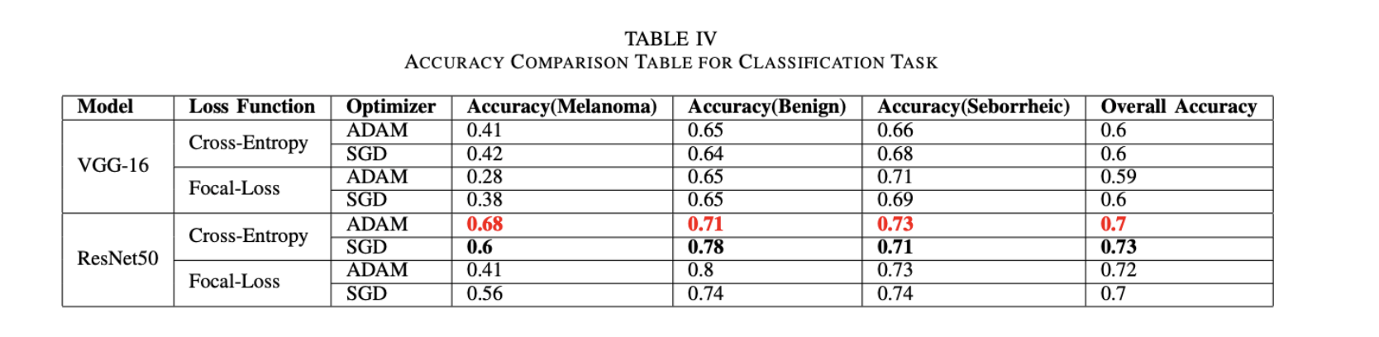
RESULTS (DL): AUTOMATIC SEGMENTATION
(U-NET)

Slide 34

RESULTS (DL): AUC COMPARISON

Slide 35

RESULTS (DL): ROCs FOR RESNET50 MODELS

Slide 36

RESULTS (DL): ROCs FOR VGG16 MODELS

Slide 37

RESULTS (DL): COMPARISON FOR CLASSIFICATION MODELS

Slide 38

RESULTS (DL): CLASSIFICATION

